Slide 1
SAP Mobility Strategy October 18th, 2011 Dominique Congnard – VP EMEA Mobility

Slide 2
Agenda
Why Mobility
SAP Mobility Strategy
How Can we Support You

Slide 3
Agenda
Why Mobility
SAP Mobility Strategy
How Can we Support You

Slide 4
The World is going mobile!
Over 5 billion people today
$100+ billion transactions will be mobile in 2011
Online becomes mobile

Slide 5
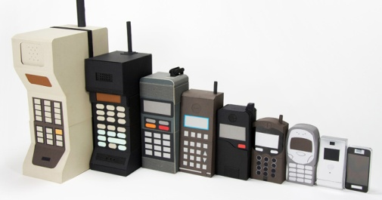
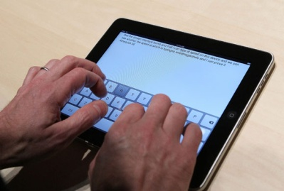
Key Trends are facilitating
Technically possible:
advances in software, infrastructure & devices technology
4.1B
Economically feasible:
Consumer driven IT provides economic justification
140,000
Business Imperative:
Traditional computers being bypassed
70%
Notes:
Technically Possible:
Advances in mobility technology (operating systems, SDKs) allows fast development of mobile applications providing a rich user experience at a low cost. 50% of organizations planning to deploy mobile apps in 12 months^{3;}
Advances in mobility infrastructure (faster networks, variety of sensors, advanced GPSs, Machine to Machine technologies, etc.) allow mobility solutions to deliver additional value for the enterprise –
Devices Expand - 7x More Mobile Internet Connections Than Broadband Worldwide Today¹
4.1B phones
>4 billion mobile users
>1 billion mobile workers touching customers, partners and suppliers
Economically Feasible:
Globalisation of business, new business models (networked business) and heightened competition demand increase worker mobility and faster business processes (ability to access and act on information anytime anywhere) - Large enterprises expect to triple their smart phone user base by 2015, 1B smart phones and 1.2B mobile workers by 2013^{1,} 60% of Fortune 1,000 will deploy collaboration tools by 2013
Strong end user adoption of mobile technology - End users pressure to bring their mobile consumer experience into the enterprise
46% of large enterprises support personal owned devices
2 billion downloads of 140,000 apps from Apple App Store,
20% of mobile workers are getting business apps from app stores today
Impérative
Top 10 priorities for 70% of CIOs
Mobile is the next desktop
BRIC – 70%+ will go directly to mobile bypassing traditional computers
Data Expands- Volume of Data Doubles Every 18 Months² - if we do not act on the information immediately it will be buried
400m Facebook users
15m twitter
1B Meters
10B Readers
1T Sensors
Action Points Expand - Growth in Corporate Apps Accessed from Smart Phones - +43% CAGR from 2008 to 20113
1 – Yankee Group, 2008
2 – Yankee Group – enterprise storage study – 2008
3 – J. Gold Associates, November 2008

Slide 6
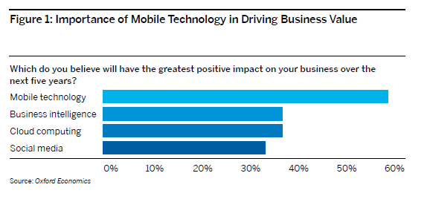
Mobility is expected to have the greatest positive impact on business landscape among technology trends
Notes:
In a recent Oxford Economics survey, respondents were asked to identify four digital megatrends that they believe will have the greatest positive impact on the business landscape.
Mobile technology topped the list, as shown. Respondents across all sectors, in firms of all sizes, and in both the developed and emerging worlds consistently rated mobility as a game changer.
In fact, more than 50% of respondents within each sector indicated that their firms will invest heavily in mobile technologies over the next five years

Slide 7
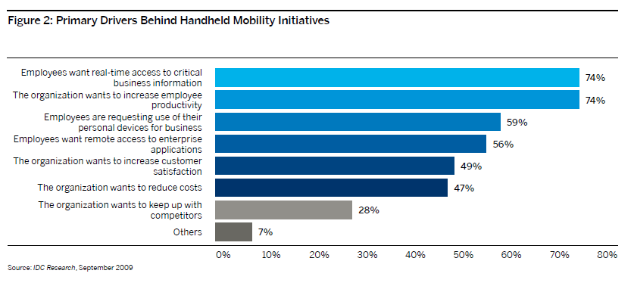
Why Mobility - increasing productivity and increasing customer satisfaction
Notes:
Mobile applications can speed processes and support rapid decision making, and both aspects translate into increased productivity.
Dynamic reports let consultants make quick decisions online and communicate them to clients in the moment. Since the workforce
is geographically dispersed, information needs to flow when and where consultants need it. As evidence, IDG Research
reports that 74% of companies are deploying mobility to provide employees with real-time access to critical business information and to increase
productivity

Slide 8
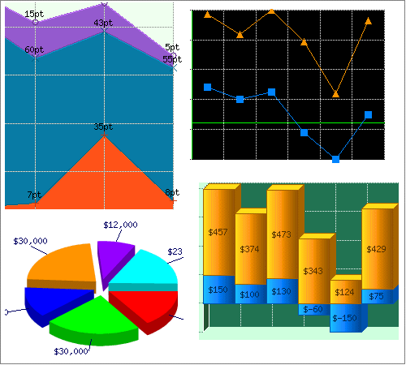
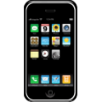
Mobility addresses diverse stakeholder requirements
Execs
Mobile Dashboards
Mobile Management Apps
Mobile Customer View Apps
Knowledge Workers
Mobile Employee Productivity Apps
Mobile Collaboration Apps
Mobile Business Analytics Apps
Task Workers
Mobile Field Service Apps
Mobile Asset Mgt
Mobile Sales Apps
Mobile Industry Apps
Consumers
Marketing Apps
Banking Apps
Commerce Apps
Citizen Apps
Notes:
This pyramid diagram showcasesall of the stakeholders in an enterprise, what business processes they perform, and how these processes are escalated.
Mobility is being adopted across the entire enterprise – from task & business users to execs and line of business managers. Although their mobility needs may differ, a single platform can be used to address both application creation and device management and security needs, which helps to reduce both complexity and cost.
A mobile enterprise application platform is the type of single platform that can address the needs of each stakeholder within the enterprise. I will explain the components of a mobile enterprise application platform in the next few 2 slides and how the Sybase Unwired Platform is the industry’s most scalable, secure, and reliable solution for mobilizing enterprise applications to heterogeneous mobile devices
What resonates with this chart (which was used in the March launch of our relationship with SAP), is that we’re not talking about a certain type of application or device, or role within the enterprise, we’re talking about the mobility means within the enterprise, which should be dealt with from a cross-functional infrastructure perspective.
The bottom layer is where Sybase has been historically strong, our acquisition by SAP has put us in the ideal position to expand up.
An example of our ability to delvier a solution at the LOB layer would be a southern California entertainment company does 1M approvals per year using mobile devices, which not only saves significant time, but has saved then millions in air far reduction. We can do a pilot like this w/in two weeks.

Slide 9
Agenda
Why Mobility
SAP Mobility Strategy
How Can we Support You

Slide 10
Enterprise Mobility Requirements
Security: Combined personal & business use of devices
Consume
Allows your users to use the mobile applications from the mobile device of their choice
Control
Allows businesses to manage and secure mobile devices with full confidence
Security: Lost or stolen devices
Security: Unnauthorized data access
Create
Build compelling mobile applications using standard IDEs
Connect
Enables your users to communicate and interface with any data source and applications
Security: Gaps in Device management & policy enforcement
Notes:
Security Risks
Security best Practices:
Lost or stolen devices - 33% report using data encryption on mobile devices
User authentication at the device level
Remote lock and wipe
Data encryption
Data fading
Combined personal and business use of devices - 61% report that business use of smart phones is their top security concern
Segregating business functions on the mobile device
Remote data wipe
Data fading
Unauthorized data access - 54% report at least one security breach in the last year
Remote provisioning and configuration updates
Event and activity monitoring and logging
Enforcing security policies
Gaps in device management & policy enforcement – 33% report requiring advanced authentication for corporate network access
Single security platform to deal with all devices (including outside the reach of IT) and for the expanding range of mobile applications

Slide 11
Sybase – Innovation in Mobility Since 1992
2008 First secure enterprise email support for iPhone
2003 Launch of the “Unwired Enterprise”
1995 First mobile computing sync
1992 First mobile database
Today Mobility products make up: - 32% of total revenue - 50% of licenses & messaging revenue
1994 First mobile management solution
1998 First mobile web platform
2006 Becomes world’s largest provider of mobile messaging services
Notes:
Key points:
Sybase has a long history in the mobility space
Sybase mobility products are based on proven, industry-leading technology
Mobility products are a substantial and growing part of Sybase’s business
Milestones:
-iAnywhere is known as a pioneer in the mobile market, introducing the industry’s first mobile database for laptops in 1992, and the first mobile enterprise synchronization in 1995 (SQL Anywhere Studio (ASA and SQL Remote)
-In 1994, pioneers industry’s first mobile management solution (xcelleNet)
-In 1998, M-Business Server (AvantGo) was introduced, the first platform for mobile Web content and applications.
-In 1999, we unveiled UltraLite, targeting handheld and memory constrained devices.
-2000- Sybase forms iAnywhere subsidiary to capitalize on growth opportunities in mobile and wireless
-2002 – Named Mobile database leader for 6^{tth} consecuritve year by Gartner Dataquest, 73% marketshare.
-2003, iAnywhere named the mobile middleware leader by IDC for the second consecutive year
-2003 –Sybase completes acquisition of AvantGo, a leader in mobile enterprise solutions, and integrates into iAnywhere subsidiary.
-2004- Sybase acquires XcelleNet and integrates it into the iAnywhere subsidiary. Acquisition solidifies the company's number one leadership position in mobile database, mobile middleware and mobile and remote device management categories; and adds critical mobile data security solutions.
-2004- Sybase acquires Dejima, Inc. and integrates it into the iAnywhere subsidiary. Acquisition puts the company at the forefront of providing natural spoken and text access to backend systems
This history of innovation continues with a long list of industry firsts, awards and customer successes.
Over 1800 new Enterprise Mobility Customers over the past 12 months.
SAP set as a strategy to reach 1 billion users by 2015. After years of experience in that space and having developed multiples mobile technologies, SAP decided to acquire Sybase in 2010. Sybase was at that time 1 Bi USD revenues and booming business in DB, Messaging and Mobility.

Slide 12
SAP Provides Complete Mobility Solution
Mobile Services
Mobile Applications
SAP Mobility Platform
Notes:
12

Slide 13
SAP Mobility Platform – SUP and Afaria
Mobile Services
Mobile Applications
SAP Mobility Platform
Create
Connect
heterogeneous
data sources
Eclipse
Consume
heterogeneous
mobile devices
Sybase Unwired Platform
Mobile
Business
objects
Container Apps
Native Apps
Afaria Management console
Control
Device and server management and security

Slide 14
SUP Reduces Mobile Application TCO
Mobile Services
Mobile Applications
SAP Mobility Platform
The Rule of Three
A mobile platform significantly reduces TCO and accelerates deployment if you have:
3 or more mobile apps
3 or more integration points
3 or more mobile device types
Application Development
Connection Management
Data Synchronization
or
Data Security (on device and OTA)
ERP, Database, Business App integration
Version Control
Device Detection and Management
or
Mobile Client Databases for offline use
Infrastructure Platform Services
Logging & Reporting

Slide 15
Top 5 Reasons Why Sybase Unwired Platform 2.0
Sybase Unwired Platform provides integration into backend systems (MBOs) | SAP certified connectors Open standard connectors Ability to cache data
Sybase Unwired Platform manages the entire application lifecycle | Deployment (Tooling) Provisioning Management Updating
Sybase Unwired Platform easily enables your app to be Push-Enabled | iOS — Apple Push Notification Service integration BB — BES integration Windows Mobile — Http Push
Sybase Unwired Platform provides security | Proprietary transport encryption between container and server Authentication options Data encryption
Sybase Unwired Platform HTML Container provides Native Services | Container supports all the advantages of a web app + the ability to support native functionality in the future because the container is a native app so you will see camera, GPS, PIM App integration like in a native app, etc.
1
2
3
4
5

Slide 16
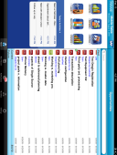
Afaria – Managing and Securing the Device Lifecycle
Mobile Services
Mobile Applications
SAP Mobility Platform
Manage
Track asset
Update/repair software
Maintain/modify configuration
Distribute/update files
Software license tracking
Schedule/automate activities
Device remote control
Secure
Back-up data
Apply patch/security updates
Enforce security policies
Monitor/track security violations/threats
Compliance activity logging
Manage
Assign membership/policies
Configure devices
OTA client delivery
Application deployment
Secure
Establish policies
Initialize power-on password
Install and encrypt data
Install and configure AV, firewall, controls
Provision
Production
Decommission
Secure
Disable lost/stolen device
Remote kill/lock
Access violation lock
“Data fading”
Disable device, network, application access
Manage
Reprovision/reimage device
Replacement device-same user
Repurposed device
Redeploy software assets
Restore data (after device kill)
Direction
Enhanced administrative UI
Location tracking
Telecom Expense Monitoring
Analytics Integration
Notes:
16
Afaria addresses the concept of managing and securing mobile devices through the entire cycle of it’s life. Provisioning represents the first stage of a device’s life. In the provisioning stage, group and membership assignments are made and well and configuring for type of connectivity and initial Over-The-Air delivery of the management client. The provisioning stage includes security set up as well. Delivering the security client, establishing power-on password and encryption policies as well as antivirus and firewall protection are crucial in provisioning. Once completed, a device moves to the production phase in the device life cycle.
It is in the production phase in the device life cycle where the bulk of what’s expected of a mobile device occurs. In order to maximize mobile devices and make it as efficient as possible, there are specific functions that must be addressed. Things like tracking inventory, the ability to update and repair software that’s deployed on mobile devices, distribute data and content to line of business applications and remote control capabilities are all things a mobile device management solution must accomplish.
Security is a integral part of the production phase, too. Being able to back up data, apply necessary OS patches (laptops), enforce the security policies set in the provisioning phase and providing detailed logging and reporting are critical security functions of the production phase in a device’s life cycle.
Maybe as important as provisioning is the decommissioning of a device. Many time the story is heard about a device sold on eBay with corporate data still contained on the device. That device was victim of a poor decommissioning process. You have to be able to lock or kill a lost or stolen device, or wipe all data from devices due to be removed from the inventory and repurposed. If a device is going to be re-provisioned , a new functional image will have to be placed on the device, as well as the appropriate applications and settings.
These are all things that can be accomplished with the Afaria mobile device management and security solution.

Slide 17
Technology roadmap principles
Gorgeous user experience
Open standards
Fast development
Consistent mobile infrastructure and development platform

Slide 18
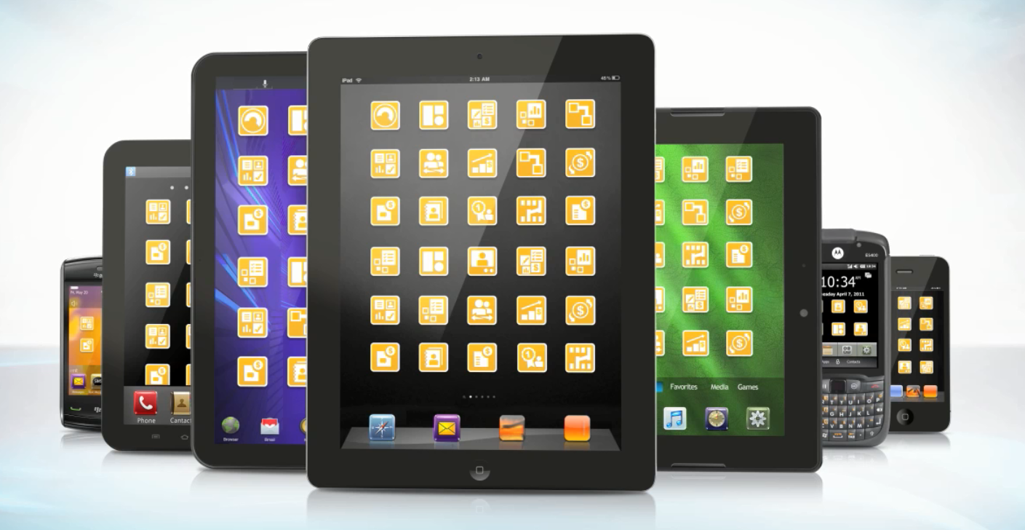
Mobile Apps Launch

Slide 19
Mobile Applications
Mobile Services
Mobile Applications
SAP Mobility Platform
Process Workers
Knowledge Workers
Consumers
Sales
Service
Mobile Asset Management
Yard Management
Retail Execution
Travel
Medical Records
Human Resources
Approvals
Procurement
eCare
eCitizen
eBanking
eRemittance
10,000 Users
100,000 Users
10,000,000 Users
Intensive Apps
Light Apps
Consumer Apps
Features
Increasing Simplicity
Single Purpose
Must Have
Changing Case
Convenience

Slide 20
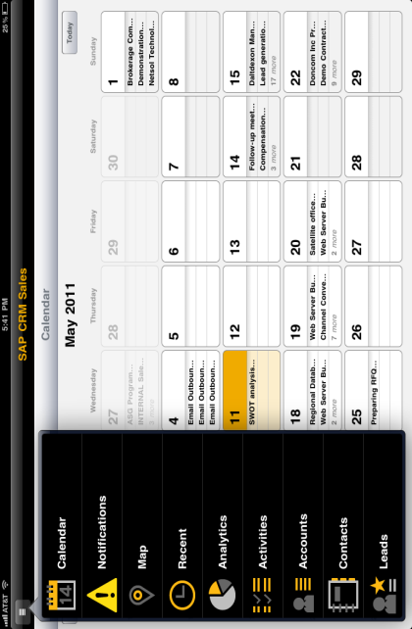
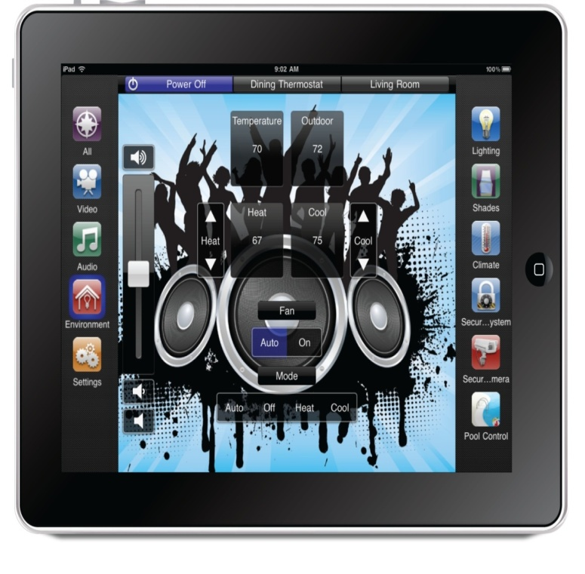
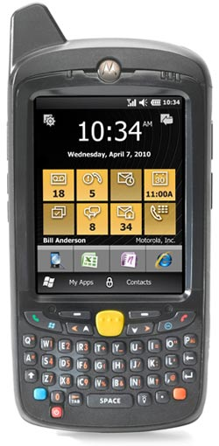
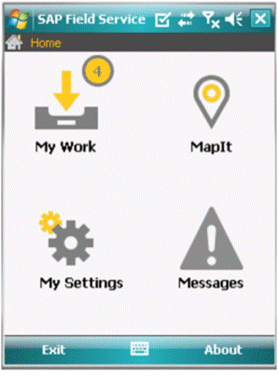
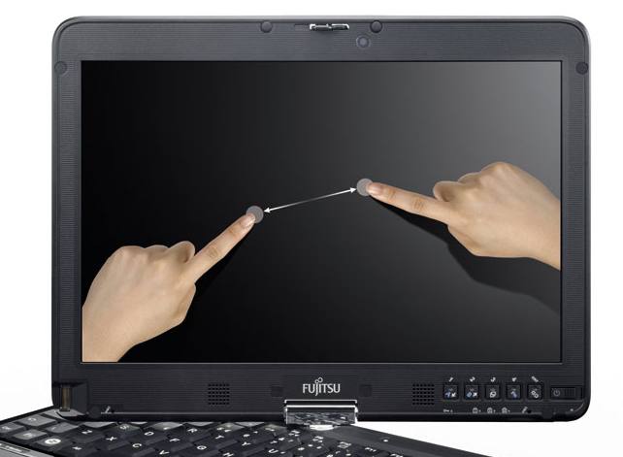
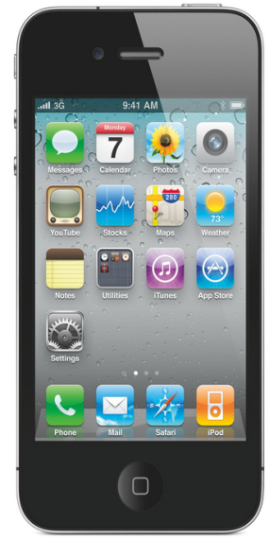
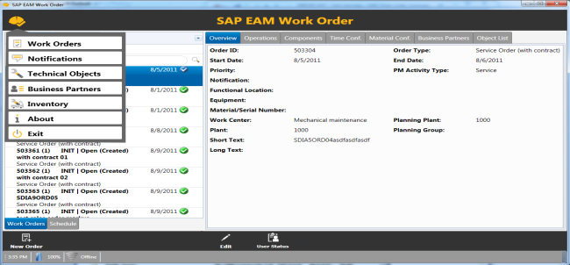
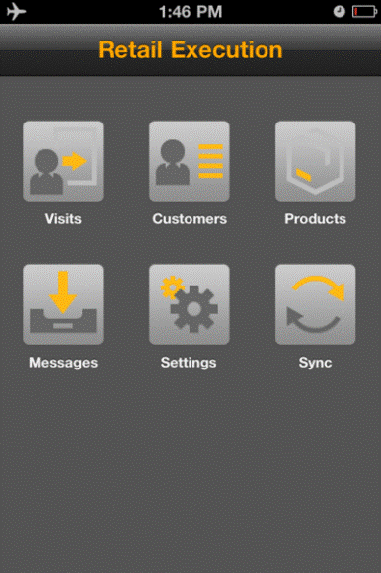
Mobile Process Apps
Mobile Services
Mobile Applications
SAP Mobility Platform
SAP CRM SALES mobile app
SAP Field Service mobile app
SAP RETAIL EXECUTION mobile app
SAP EAM WORK order mobile app
SAP Electronic Medical Record Mobile app
Notes:
The way I think of process apps is to think about the user. These apps are critical companions throughout the day.
SAP CRM Sales – description of the app focused on the business benefits and target customer opportunity
SAP Field Service – description of the app focused on the business benefits and target customer opportunity
SAP EAM Work Order – description of the app, using the customer example (CN, Energy East, Fraport, or another….anecdotal story from my past life) as the story line for why SAP customers need to mobilize asset management
SAP Retail Execution - description of the app, talk about how much the CP industry spends on promotions, and then use McCormick Spices as the customer example (again, past life experience to describe the importance of mobilizing this functionality, not as an example of this app deployed because its NEW!)
SAP EMR - description of the app that sets up Gary’s wow EMR demo that will come later!

Slide 21
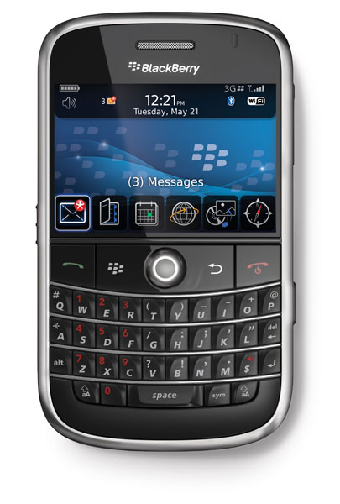
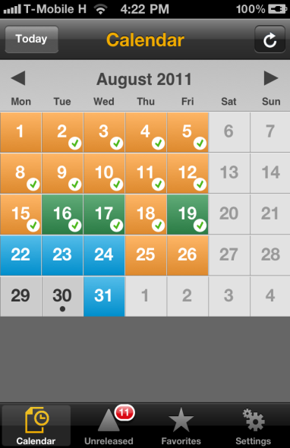
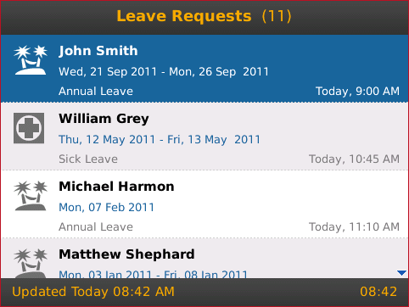
Mobile Productivity Apps
Mobile Services
Mobile Applications
SAP Mobility Platform
Human Resources
SAP Employee Lookup mobile app
SAP Leave Request mobile app
SAP Timesheet mobile app
SAP HR Approvals mobile app
SAP Interview Assistant mobile app
SAP Manager Insight mobile app
Finance
SAP GRC Access Approver mobile app
SAP GRC Policy Survey mobile app
SAP Payment Approvals mobile app
SAP Travel Receipt Capture mobile app
SAP Travel Expense Approval mobile app
SCM and Manufacturing
SAP ERP Quality Issue mobile app
SAP Cart Approval mobile app
SAP Transport Notification & Status mobile app
SAP Transport Tendering mobile app
Sales
SAP Sales Order Notification
SAP Material Availability
SAP Customer & Contracts
SAP Customer Financial Fact Sheet
SAP Order Status
Notes:
Human Resources apps – description of the app focused on the business benefits and target customer opportunity
Huge opportunity to expand the footprint with existing customer accounts (we average 15 to 20% of the employee base as licensed SAP users, but these apps are applicable, affordable, and drive productivity for all employees)
Use the example of booting a laptop, logging in, VPN’ing in, SSO, launching the browser, going to the portal, navigating to the approval screen, and then finally hitting approve vs. mobile ‘instant productivity’ experience
We can also see ways were they can transform our business processes. For example, SAP Manager Ins
Procurement apps
Use the RIM as a customer example for mobilizing SAP purchase order requisitions, not with this app as its NEW, and not quoting RIM as the customer
They went from an average requisition approval time of 28 days to under 24 hours when ‘approvable’ on BlackBerry
Finance apps
Use Deloitte as a example of an organization that has spent multi-millions mobilizing SAP Time Sheet.
Sales apps - description of each app focused on the business benefits and target customer opportunity

Slide 22
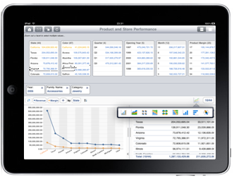
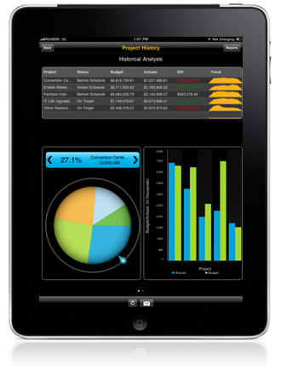
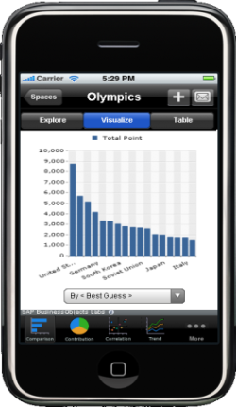
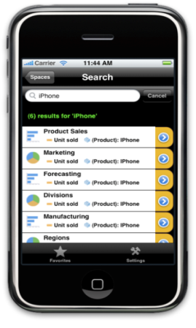
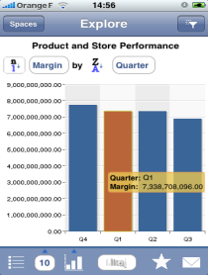
Mobile Analytics Apps
Mobile Services
Mobile Applications
SAP Mobility Platform
SAP Business objects mobile
SAP Business objects Explorer
SAP Business objects Strategy MGt
Notes:
BusinessObjects Mobile – description of the app focused on the business benefits and target customer opportunity
BusinessObjects Explorer Mobile – description of the app focused on the business benefits and target customer opportunity
BusinessObjects Strategy Management – description of the app focused on the business benefits and target customer opportunity

Slide 23
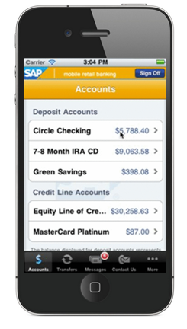
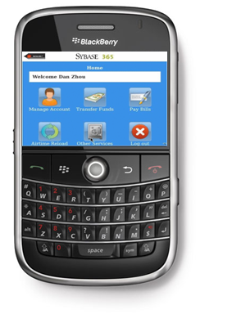
Mobile Consumer Apps
Mobile Services
Mobile Applications
SAP Mobility Platform
Enable commerce on any mobile device (SMS, Near Field, 3D Barcode, Mobile Wallet)
Open marketing channel to mobile device engaging loyalty programs
Support industry specific consumer apps
mCommerce
mPayments
mRemittance
mBanking
Create browser based apps on gateway
SAP Citizen Connect
Notes:
Citizen Connect – description of the app focused on the business benefits and target customer opportunity
mBanking – description of the app focused on the business benefits and target customer opportunity
Call to Action for all AEs that have customers that need to reach their customers. Use The Home Depot example of percentage of online customer that make purchases vs. percentage of mobile shoppers, and the average time to purchase of each.

Slide 24
Enhancing the Mobile Apps Portfolio Sybase technology-based applications only (SUP & m365)
SAP Built
Partner Built
1
Light
Enterprise
2
Consumer
3
Apps
Apps
Apps
Total Apps = 43
Types of Apps
Employee Lookup
Travel Capture Receipt
Time Capture
Leave Request
HR Approvals
Sales Order Notification
Customer & Contacts
Material Availability
Cart Approval
Supplier Search
Travel Expense Report
Travel Expense Approval
ERP Quality Issue
Access Approver
Payment Approvals
Customer Financial Fact Sheet
GRC Policy Survey
Order Status
Equipment Fact Sheet
Account Management
Brochure
Point of Sale
Analytics
Virtual Boardroom
LoB
EAM Work Order
CRM Sales
Manager Insight
Interview Assistant
iPeople
Skillscanner
CRM Mobile Retail Shopper
Scheduler for SAP Order Management
Loyalty Shopping Assistant
Citizen Connect
E-Care Management
Light
22
Enterprise
18
Consumer
SAP vs. Partner
Industry
Electronic Medical Record
Transport Tracker
Transport Tendering
Compliance & Regulatory Insight
Asset Visualizer
Drug & Device Authentication
In Transit Asset Tracking
Consumer Fashion
SAP
28
Partner
15
*Subject to change
Notes:
Click through quickly

Slide 25
Agenda
Why Mobility
SAP Mobility Strategy
How Can we Support You

Slide 26
SAP Services Portfolio for Mobility Future proposal for service-cut
PLAN
BUILD
RUN
Planning Mobile Solutions (Results in Mobile Strategy + Business Architecture + high-level Technical Architecture)
Design & Build Custom Mobile App (Design + Development + Tailoring)
Support for Custom Mobile Applications
Create
Deployment of Mobile Apps (Deploy standard and custom mobile apps - leveraging existing implementation services and RDS)
AMS for Mobility
Consume
Mobile Discovery Workshop Understand mobility challenges and enablers for the business
Post Go-Live Support
Quickstart SUP (Setup sandbox + knowledge transfer – getting started)
Design & Setup Mobile Infrastructure (Detailed IT architecture (incl. security + sizing) and installation of required components)
Connect
Platform Upgrade Support Services
Quickstart Afaria (Setup sandbox + knowledge transfer – getting started)
Design & Setup Mobile Device and Application Management (Concept for MDM + setup Afaria + Operations Design & Governance)
Control
Device Change Management
Project Management (incl. QA + Risk Management)
Business Process Management & Value Realization
Trainings & Certification
Support & Maintenance (+ MaxAttention & Safeguarding for Mobility)
Legend:
Core Services
High Value Services
Innovation Services

Slide 27
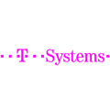
SAP Mobility Partner Ecosystem
System Integrators
Software Partners
Implementation
Mobile Apps
Interoperability
Solution Hosting
Mobile Services
Net4Site
Technology Partners
Mobility Partners
Managed Mobility Partners
Notes:
27

Slide 28
SAPPHIRE NOW Madrid, 9-10 November 2011
Mobility as Major topic
Mobile applications
Ecosystem
App & Demo Showcase

Slide 29
Why SAP Mobility Solution?
Most comprehensive mobility platform
Best integration with SAP Business Suite
Rapidly expanding Mobile Application Portfolio
Best rated solution by industry analysts
Afaria: Top ranked in Forrester Wave™ Mobile Device Management Solutions report
Leader in Mobile Device Management for 9th years and mobile middleware for the 8th year
Sybase recognized in the Leaders Quadrant from Gartner’s Magic Quadrand in MDM
Notes:
Sybase is recognized by all top analysts as having the best mobile platform in the industry.
SAP and Sybase have been co-innovating on the mobility platform and applications for over 2 years before the recent acquisition. This co-innovation has resulted in the most comprehensive platform for B2E and B2C mobile applications, that is tightly integrated with SAP Business Suite and with ever expanding mobile application portfolio of the applications from SAP and our ecosystem that makes it easy for you to mobilize all your business processes.
We believe our mobility solution is the best and shortest route for you to further realize the value of your SAP investment and take advantage of the opportunity offered by mobility trends and get in front of your competition by using mobility to speed up your business, improve the day to day business outcomes, and get closer to your customers.

Slide 30
Thank You!
Contact information:
Dominique Congnard
Vice President,
EMEA Mobility
d.congnard@sap.com
+33 66 33 12342

